Slide 1
SDLC
Sunil Nagaraj , 21/10/21

Slide 2
Software Development

Slide 3
Software Development Life Cycle

Slide 4
Software
Software is defined as set of instructions to perform specific task

Slide 5
Software Development Life Cycle
SDLC is a process of converting user requirements into fully developed software.
SDLC is step by step procedure to convert user requirements into a software
SDLC involves activities required to transfer user information in fully developed software
SDLC starts with identification of requirements & ends with validation of developed software against its requirements

Slide 6
SDLC Phases
REQUIREMENT
FEASIBILITY
STUDY
DESIGN
CODING
TESTING
MAINTENANCE

Slide 7
Requirement
Requirements definition is the process by which the needs of the customer are translated into a clear, detailed specification of what the system must do.
Requirements will be collected from the clients.
Testing should begin in the requirements phase of the Software Development Life Cycle.

Slide 8
Feasibility Study
Feasibility study is used to determine if the project should get the go-head.
If the project is to proceed, the feasibility study will produce a project plan and budget estimates for the future stages of development.
In this phase, the development team visits the customer and studies their system.

Slide 9
Design Phase
During design phase, testers work with developers in determining what aspects of a design are testable and with what parameters those tests works.
Types Of Design
High Level Design [HLD]
Low Level Design [LLD]

Slide 10
High Level Design
High level design on SDLC, software analysis will convert the requirements into a usable product in terms of functional architecture and data base design.
It designs the over all architecture of the entire system from main module to all sub module. This is very useful for the developers to understand the flow of the system.
For this the entry criteria are the requirement document that is SRS and the exit criteria will be the HLD projects standards the functional design and the database design documents

Slide 11
Low Level Design
Specification for each program in the system is finalized
In Low level design we create more detail and specific design of the system.
The Low level document gives the design of the actual program code which is designed based on the HLD document
Functionality and logic is designed in detail for sub-modules.

Slide 12
Coding Phase
After design we do coding.
The design must be translated into machine readable form.
Different High level programming languages like c, c++, java are used for coding.
With respect to the type of application, the right programming language is chosen.

Slide 13
Testing Phase
Once code is generated , the software program testing begins.
Testing is catching bugs on executing the program.
Testing is the process of confirming whether developed software meets the customer expectations

Slide 14
Maintenance
A good software product should effectively respond to the changing requirement of the customer or user.
Any modification which needs to be taken care in the developed software will happen in maintenance phase

Slide 15
SDLC Models

Slide 16

SDLC MODELS
Generic software process models
Waterfall model
Evolutionary models
Prototyping model
Spiral model
Incremental models
Iterative model
RAD model
Agile models
Scrum
Notes:
Process models or development lifecycle models are some kind of frameworks which contain a set of processes or methodologies that are being selected for the development of the projects depending on the project's aims and goals. There are various development lifecycle models to achieve different required objectives. The models specify the various stages of the process and the order in which they are carried out.
For example, does a civil engineer always use a same methodology to construct various types of buildings? Of course not. Based on the size, strength requirement and complexity of the building, she has to employ different methodologies to build it.
Similarly, there are different software development lifecycle models available to develop the system based on various parameters like timeline, project scope, project type, clarity about requirements, user involvement and more.

Slide 17
WATERFALL MODEL
Classical life cycle and linear sequential model is widely used
Suggests a systematic sequential approach:
Conception & Initiation
Analysis
Design
Construction
Testing
Deployment
Maintenance / Support
Operation and Maintenance
Integration and Testing
Implementation
Design
Requirements specifications
Analysis
Notes:
Classical, linear-sequential model. One phase has to be completed before another phase activities are taken up. As can be seen in the diagram, one phase provides inputs to the next phase, next one to its next phase and so on which looks like a water flowing down through a set of steps, hence the name Waterfall model.
Once the initiation is complete, its inputs are taken to elaborate the requirements and analyze them, which further provides inputs to the design phase and so on.

Slide 18
WATERFALL MODEL
Phases of Waterfall Model
Initial analysis
Specifying the problem background, business goals and success criteria
Requirement analysis and definition
The goals and constraints of the system to be developed are established in consultation with system users
They are then defined in detail and serve as a system specification
System and software design
Partitions the requirements to either hardware or software
Software design involves identification of necessary fundamentals of the software requirement and their relationship with those systems
Implementation
Whole of software components are integrated as a set of programming units

Slide 19
WATERFALL MODEL
Phases of Waterfall Model (contd …)
Unit testing
Involves verifying that each unit meets its necessary requirement
Integration and system testing
The individual program units are integrated and tested as a one complete system to ensure that all the necessary requirements have been met.
Deployment/installation
After testing the system is installed in the final environment
Operation and maintenance
Longest life cycle phase
Involves correcting the encountered errors which were not discovered at earlier stages
Also by enhancing the systems services, new requirements are discovered

Slide 20
WATERFALL MODEL
Traditional Model
Practitioner’s Model
Operation and Maintenance
Integration and Testing
Implementation
Design
Requirements specifications
Analysis
Requirements
Analysis
Design
Coding
Testing
Deployment & Maintenance
Notes:
As it is known, in a traditional waterfall model, one phase has to complete before the next phase starts. For some reason, if it's found that activities done in an earlier phase is incorrect or inappropriate (e.g. if it's found that requirements were not captured properly in the testing phase), this model doesn't suggest any procedure to go back to that phase.
In the revised, practitioner's model this constraint is handled by allowing to go back to a previous stage from any stage to fix any problems that was introduced during an earlier stage.

Slide 21

WATERFALL MODEL
Advantages
Easy to understand and Implement
Widely used and known
Reinforces good habits: define-before-design
Identifies deliverables and milestones
Document driven
Works well on mature products and weak teams
Fits other engineering process models

Slide 22
WATERFALL MODEL
Disadvantages
Idealized, doesn’t match reality well
Does not reflect iterative nature of exploratory development
Unrealistic to expect accurate requirements early in the project
Delays discovery of errors
Difficult to integrate risk management
Difficult to accommodate change after the process is underway
One phase has to be competed before moving to the next phase.
Difficult and expensive to make changes to document

Slide 23
WATERFALL MODEL
When to use?
Requirements are very well known
Product definition is stable
Technology is understood
Creating a new version of an existing product
Porting an existing product to a new platform

Slide 24
PROTOTYPING MODEL
Allows users of the software to evaluate developers' proposals for the design of the final product by actually trying them out by means of a prototype of the screens
Avoids the hardship of end users having to interpret and evaluate the design based on descriptions
Users review and provide feedback on changes required for the prototype
This is repeated until all requirements of system are identified
Identify basic requirements
Develop initial prototype
Review
Revise & Enhance
Plan & Design
Notes:
A prototype is like a working model of a software with limited functionality. The focus is to show how the screen looks like and how the transition happens across screens. There will be no business logic built into it. Such models help users give clear requirements (for human beings can understand more clearly the things which they can see rather than only hear).
Once the requirements are gathered, more functionality can be built into this prototype model itself with appropriate business logic to evolve into the final product. Such prototypes are referred as evolutionary prototypes. Web applications are a good candidates to this model; HTML based screens can be evolved further to develop the complete system.
Throwaway prototypes are the ones which are used for showing how the screens look like and later discarded once the requirements are clear.

Slide 25
PROTOTYPING MODEL
Advantages
Users are actively involved in the development
Errors can be detected much earlier
Quicker user feedback is available
Missing functionality can be identified easily
Confusing or difficult functions can be identified

Slide 26
PROTOTYPING MODEL
Drawbacks
Leads to implementation and then repairing way of building systems
Practically this methodology may increase the complexity of the system, as scope of system may expand beyond original plans
Incomplete or inadequate problem analysis

Slide 27
PROTOTYPING MODEL
When to use?
Requirements are unstable or have to be clarified
As the requirements clarification stage of a waterfall model
Develop user interfaces
Short-lived demonstrations
New, original development

Slide 28
SPIRAL MODEL
Combines the idea of iterative development with the systematic, controlled aspects of waterfall model.
Has four phases:
Planning - requirements gathering phase (initial and also in subsequent spirals)
Risk analysis - identification of risk and alternative solutions. Creation of prototype at the end of this phase
Engineering - Development, testing & delivery of software
Evaluation - Evaluation of the software by the customer before the project continues to the next spiral
Notes:
The spiral model is iterative in nature. It combines this idea with the aspects of the waterfall model. So spiral model is a combination of iterative development process and the linear waterfall model with more focus on risk analysis.
Example: a car rental company wants to automate is complete operations – renting the car, managing returns, managing the insurance, accessories, interfacing with airlines, hotels and other travel agents, customer relationship management and many such operations.
Planning stage involves identifying the initial set of requirements (usually top priority ones). In the subsequent spirals as the application matures, identification of requirements, subsystem requirements and unit requirements are all done in this phase.
In the risk analysis phase, explore other alternatives for implementing the requirements. (E.g. ready made software). What are the risks involved in the select approach and how to mitigate them. Monitoring technical feasibility and management risks, such as schedule slippage and cost overrun are also considered during this phase. A prototype of the system is created at the end of risk analysis phase.
Once all the risks are analyzed and their mitigation plan is in place, it's time to design and build the system – Engineering phase. Remember in each spiral only part of the system in implemented. Every spiral takes the application towards complete system.
Once the application is installed and the users start using it, gather all kinds of data about the system – it's performance, difficulties phased, any incorrect / inconsistent requirements, etc. Are the front-desk clerks facing any issues while renting out a car? Consolidate all these issues and plan to go ahead with the next spiral with additional set of requirements.

Slide 29
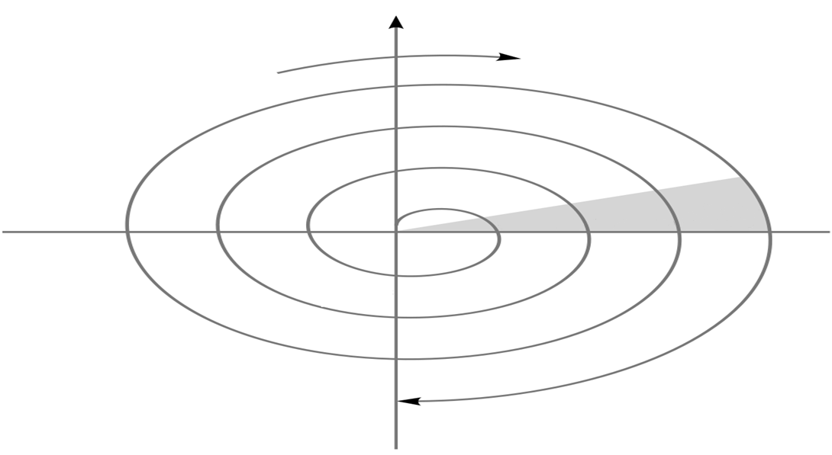
SPIRAL MODEL
Cumulative Cost
Progress
Determine Objectives
Identify and resolve risk
Review
Requirement
Plans
Prototype 2
Operational Prototype 2
Prototype 1
Concepts of operations
Concepts of requirements
Draft
Requirements
Detailed Design
Development Plans
Verification and validation
Code
Test Plans
Verification and validation
Integration
Test
Release
Implementation
Plan the next iteration
Development and Testing
Notes:
Refer to the explanation in the previous slide w. r. t. this diagram.

Slide 30
SPIRAL MODEL
Advantages
High amount of risk is resolved
Software is produced at an early stage in the software life cycle
Good for large and mission-critical projects
Strong approval and documentation control

Slide 31
SPIRAL MODEL
Disadvantages
It may be difficult to convince customers that the evolutionary approach is controllable
It demands considerable risk assessment
Can be a costly model to use
Does not work well for small projects

Slide 32
SPIRAL MODEL
When to use?
When creation of a prototype is appropriate
When costs and risk evaluation is important
For medium to high-risk projects
Long-term project commitment is unwise because of potential changes to economic priorities
Users are unsure of their needs
Requirements are complex
New product line
Significant changes are expected (research and exploration)

Slide 33
INCREMENTAL MODELS
Build 1
Iterative model
Development begins by specifying and implementing just part of the software, which can then be reviewed in order to identify further requirements
The process is then repeated, producing a new version of the software for each cycle of the model
The basic idea is to develop a system through repeated cycles (iterative) and in smaller portions at a time (incremental)
Design & Development
Testing
Implementation
Build 2
Requirements
Design & Development
Testing
Implementation
Build 3
Design & Development
Testing
Implementation
Notes:
As the name suggests, incremental models plan to deliver the product in a series of releases called increments.
Iterative process starts with taking a subset of a larger requirement and implementing it in multiple increments. Thus it iteratively enhances the evolving versions until the complete system is implemented.
Take the example of car rental application – assume customers can rent the car via multiple ways viz., online, telephonic, directly in the rental office. One release may implement over-the-counter car rental booking feature, another increment can take up, car rental booking via online method and so on.
It's important to note that during the development process, more than one iteration (incremental cycle) may be in progress simultaneously. Each iteration goes through a mini waterfall process. (Requirements, design, build, etc.) Every release adds up to the previous release which is continued till the complete system is ready.

Slide 34
Incremental/Overlapping Waterfall Model Overview:
A type of evolutionary method.
The objective is to develop the system in incremental parts.
Requirements are prioritized and then implemented in groups; “divide and conquer”.
Each subsequent release of the system adds function to the previous release until all designed functionality has been implemented.

Slide 35
Incremental/Overlapping Waterfall Model Assumptions:
Requirements are first defined and then can be prioritized.
The product is capable of partial implementation delivery.

Slide 36
Incremental/Overlapping Waterfall Model Strengths:
Provides the opportunity to incorporate user refinements, resulting from experience with earlier releases, into subsequent releases.
Provides returns for the investment in development as increments are delivered.
Satisfies changing user requirements with increments to the software released over time.
Delivers an operational product with each release.

Slide 37
Incremental/Overlapping Waterfall Model Weaknesses:
Requires good planning and design and careful partitioning of the product.
Requires well-defined interfaces between the increments, especially if they will be developed in parallel.
Requires early definition of a fully functional product to define the increments.

Slide 38
Project Factors | Life Cycle
 | Waterfall | Incremental | Prototyping | Spiral
Technology / Architecture, Stable
Technology / Architecture, New
Requirements, Stable
Requirements, Volatile
Requirements, Defined
Requirements, Vague
Risks, High
Risks, Low
System, Small and Simple
System, Large and Complex
User-Interface, High
Partial functionality needs to be delivered early

Slide 39
WaterFall is __________ model
Linear Sequential
Iterative
Incremental
Both B & C
Notes:
Answer: Linear Sequential

Slide 40
________ model will be used when there is risk involved in the software needs to considered
WaterFall
Spiral
Prototype
Agile
Notes:
Answer: Spiral

Slide 41
Agile Methodology

Slide 42
Why Agile?
Software development is to be adopted for new ways of working and technology changes.
Multi-Platform Delivery
Collaborative development
Cloud Delivery
Intelligent /
Connected Systems
Impacts on Business and Software Development:
Heavy demand for rapid product lifecycles
Increasing interactions with customer
Exploring adjacent or new markets
New skills and competencies needed
Increased security and privacy requirements
Greater need to align with strategic priorities

Slide 43
The Agile manifesto – 2001
We are uncovering better ways of developing software by doing it and helping others do it. Through this work we have come to value:
Individuals and interactions
processes and tools
Working software
comprehensive documentation
Customer collaboration
contract negotiation
Responding to change
following a plan
It means that while there is value in the items on the right, we value the items on the left more.

Slide 44
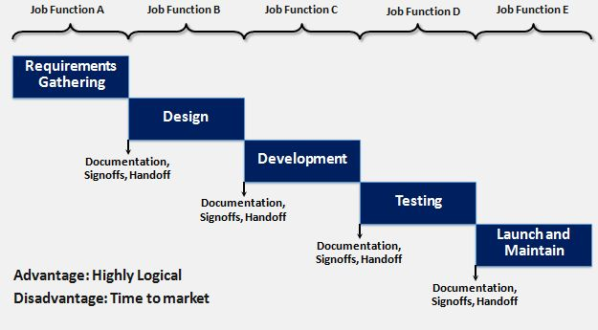
Waterfall model

Slide 45
Scrum Basics

Slide 46
What is Scrum?
Scrum refers to a holistic or “rugby” approach— where teams go the distance as a unit, passing the ball back and forth—as opposed to the traditional sequential or “relay race” approach for managing new product development.
It is not individual effort but the best coordination of the team that will determine success.

Slide 47
User Stories: Components
1 2 3
A User Story describes functionality that will be useful to a stakeholder of the system.
User Stories consists of three things
A brief description of the story used for planning
Tests that convey and document details
Conversations about the story
4
5
Assumptions
Estimating elements

Slide 48
What is an Epic?
As a premium site member, I want to cancel a reservation on the last minute with no cancellation fee so that I am not charged for a travel arrangement I no longer need.
EPIC
As an user, I want to cancel a reservation so that I am not charged for a travel arrangement I no longer need.
User Story
As a premium site member, I want to cancel a reservation on the last minute with no cancellation fee so that I am not charged for a travel arrangement I no longer need.
As a non-premium member, I want to cancel 24 hours in advance so that I am not charged for a travel arrangement I no longer need.
As a site visitor,
I want to receive a confirmation of any cancelled reservation so that I can have proof of cancellations.

Slide 49
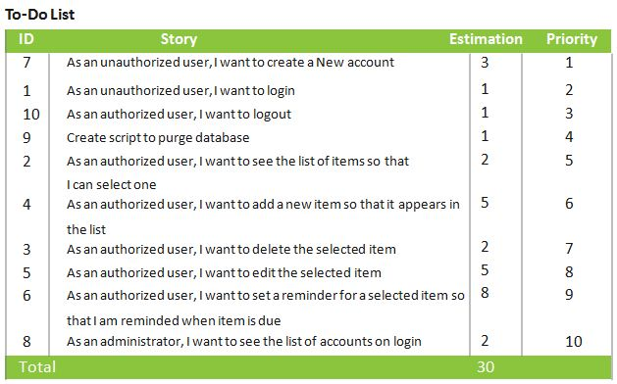
Product Backlog

Slide 50
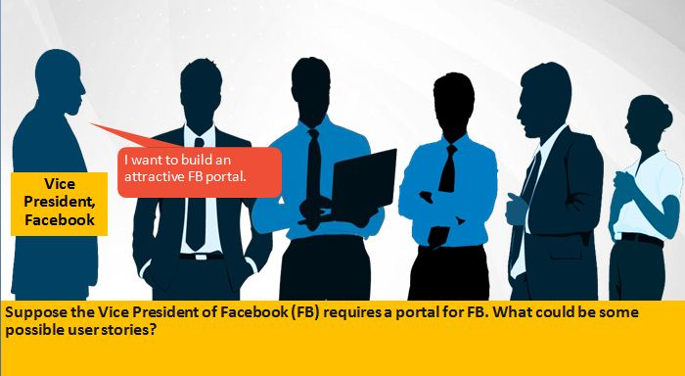
Case study : Some possible user stories(1 of 6)

Slide 51
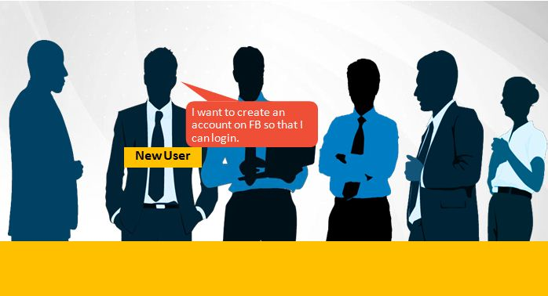
Case study : Some possible user stories(2 of 6)

Slide 52
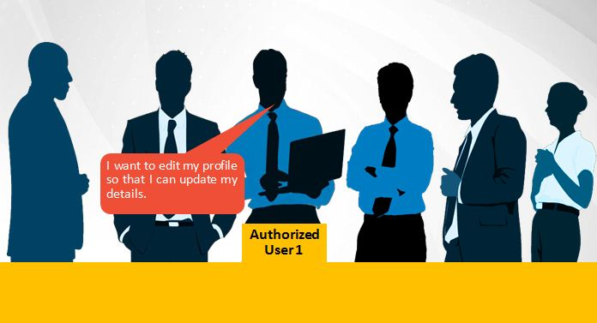
Case study : Some possible user stories(3 of 6)

Slide 53
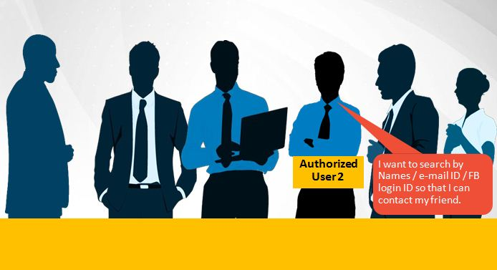
Case study : Some possible user stories(4 of 6)

Slide 54
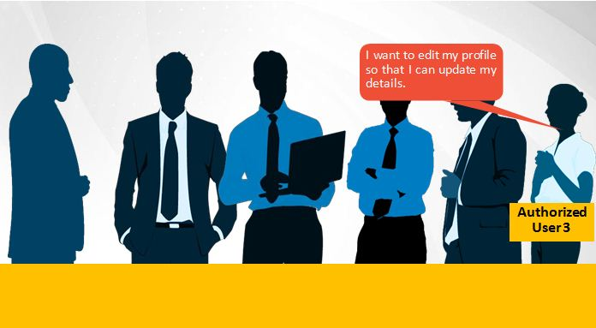
Case study : Some possible user stories(4 of 6)

Slide 55
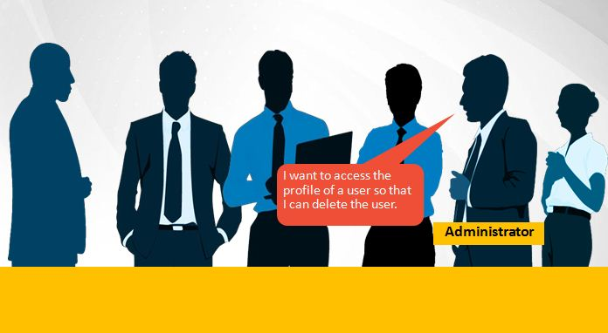
Case study : Some possible user stories(5 of 6)

Slide 56
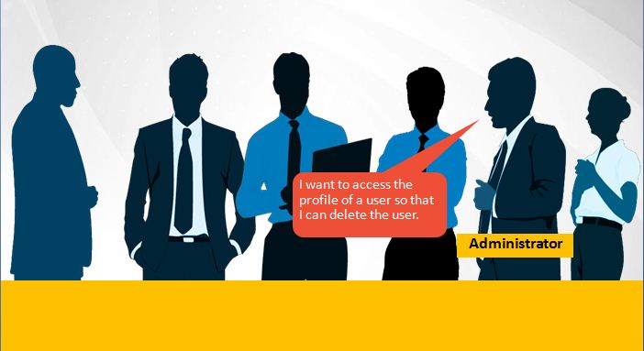
Case study : Some possible user stories(6 of 6)

Slide 57





Scrum roles and responsibilities
Scrum Meeting
Review
Scrum Master
2- WEEK SPRINT
Product Owner
The Team
Commitment
Potentially Shippable product
No Changes (In Duration or Deliverable)
Retrospective

Slide 58
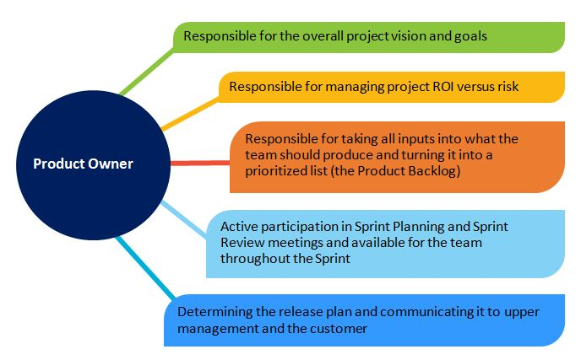
Scrum roles and responsibilities—product owner

Slide 59
Scrum roles and responsibilities—the team
7 people +
or – 2
Can be shared with other teams (but it is better when not)
Can change between Sprints (but better when they don’t)
Can be distributed (but better when collocated)
Cross- functional
Possesses all the skills necessary to produce an increment of potentially shippable product
Team takes on tasks based on skills, not just the official “role”.
Self-managing
Team manages itself to achieve the Sprint commitment.

Slide 60
Scrum Master Roles
Scrum Master
Guides the team’s use of
Scrum
Serves the team
Protects the Team
Guides the team’s use of
Scrum
Teaches Scrum to the team and organization
The Scrum Master takes action to help remove impediments to the team’s effectiveness.
The Scrum Master facilitates the team’s group interactions to help the team achieve its full potential.
The Scrum Master protects the team from anything that threatens its effectiveness, such as outside interference or disruption.
The Scrum Master will need to confront uncomfortable issues, both inside and outside the team.
The Scrum Master ensures that all standard Scrum rules and practices are followed.
The Scrum Master organizes all Scrum- related practices.

Slide 61
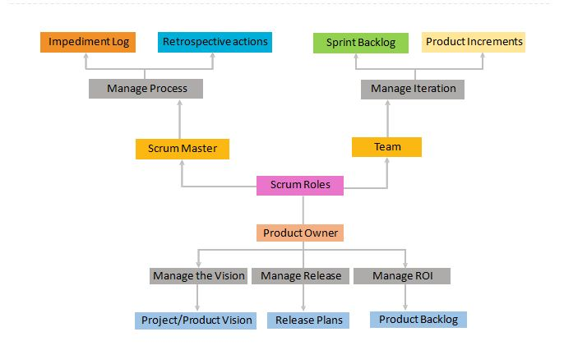
Scrum project roles in a nutshell

Slide 62
Sprint planning
What is on the Product Owner’s “shopping list”?
Team understands details of what Product Owner has prioritized on Product Backlog.
How much “money” do we have in our bank account?
Team decides how much productive time is available during the Sprint.
How many items on the shopping list can we afford to “buy” with that “money”?
Team decides how many Product Backlog items can be committed for completion during the Sprint.

Slide 63
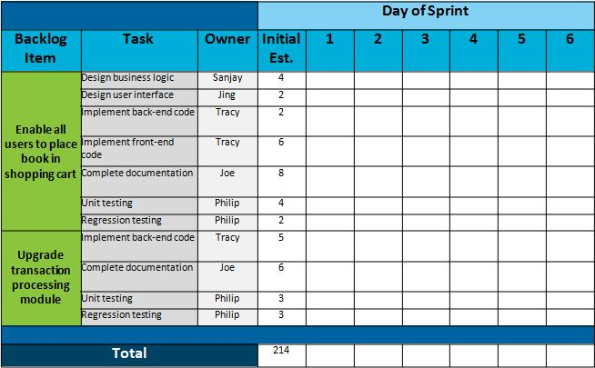
Sprint Backlog

Slide 64
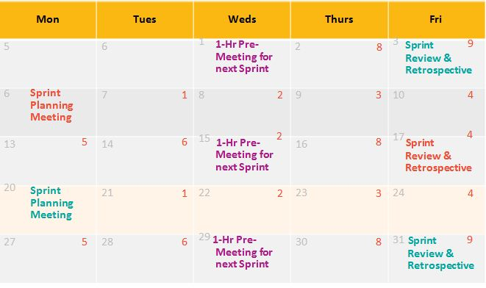
Sprint Cycle: 2 Weeks

Slide 65
Definition of Done
In Scrum, “Done” is defined as “Potentially Shippable”.
RELEASE
RELEASE
RELEASE
RELEASE
RELEASE
RELEASE
S P R I N T
S P R I N T
S P R I N T
S P R I N T
S P R I N T
S P R I N T
RELEASE
S P R I N T
S P R I N T
S P R I N T
S P R I N T
S P R I N T
PRE-RELEASE
S P R I N T

Slide 67
Which one of these life cycle models does Agile follow?
Waterfall Model
Iterative and Incremental Model
V Model

Slide 68
2. Which of the following prioritized items does the product backlog contain?
Epics
User Stories
Both A & B

Slide 69
3. Which of the below roles is not defined by Scrum?
Product Owner
Project Manager
Developer / Tester
Scrum Master

Slide 70
Scrum Execution

Slide 71
Daily Scrum Meeting
Every weekday
Whole team attends
Everyone stands
Lasts 15 minutes or less
Product Owner can attend and report
Update of artifacts after standup-Sprint backlog, Task board, and so on

Slide 72
Daily Scrum Meeting (continued)
Every Developer / Tester reports the following three things:
What task was I able to accomplish since yesterday? What task will I try to accomplish for the day?
Any issues blocking my work?
No discussions or conversations until meeting ends

Slide 73
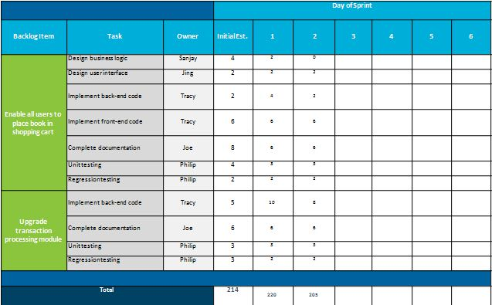
Sprint Backlog Updation

Slide 74
Kanban Task Board (1 of 4)
A Kanban board is a work and workflow visualization tool that enables you to
optimize the flow of your work. Physical Kanban boards, like the one
pictured below, typically use sticky notes on a whiteboard to
communicate status, progress, and issues.
TO DO
IN PROGRESS
DONE

Slide 75
Kanban Task Board (2 of 4)
TO DO
IN PROGRESS
DONE

Slide 76
Kanban Task Board (3 of 4)
TO DO
IN PROGRESS
DONE

Slide 77
Kanban Task Board (4 of 4)
TO DO
IN PROGRESS
DONE

Slide 79
Product Owner has to mandatorily participate in Daily Scrum Meeting.
Yes
No
Not required
Need basis

Slide 80
2. Sprint backlog is updated by:
Scrum Master
Scrum Team
Scrum Product Owner
Any of the above

Slide 81
Sprint Review and Retrospective

Slide 82
Sprint Review
The purpose of the Sprint Review is:
Demo what the team has built
Generate feedback which the Product Owner can incorporate in the Product Backlog
Attended by Team, Product Owner, ScrumMaster, functional managers, and any other stakeholders
A demo of what’s been built and not a presentation about what’s been built:
No Power Points allowed!
Usually lasts 1-2 hours
Followed by Sprint Retrospective

Slide 83
Sprint Retrospective
What is it?
1-2 hour meeting following each Sprint Demo
Attended by Product Owner, Team, and ScrumMaster
Usually a neutral person will be invited in to facilitate
Presents what is working and what could work better
Why does the Retrospective matter?
Accelerates visibility
Accelerates action to improve

Slide 84
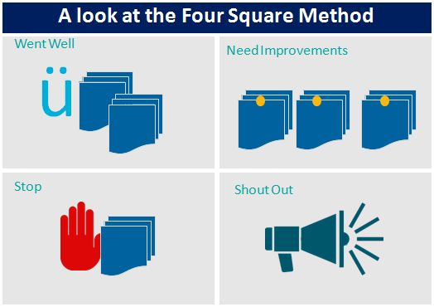
Sprint Retrospective: Four Square Method

Slide 86
Retrospective meetings help us to:
Identify areas of improvement
Recognize team members
Inspect and Adapt
A & B Only

Slide 87
QUIZ QUESTION
2. _______ is / are the one(s) who have legitimate interest in the project.
Stakeholders
Product owner
Scrum master
Scrum team
Notes:
Answer: Stakeholders

Slide 88
QUIZ QUESTION
3. Learnings of a sprint is incorporated into next sprint after a _________ meeting.
Daily scrum
Product backlog
Sprint review
Sprint retrospective
Notes:
Answer: Sprint retrospective

Slide 89
QUIZ QUESTION
4. A scrum team member should raise the issue about a software component not working, in a ____ meeting.
Sprint planning
Sprint review
Daily scrum
Customer review
Notes:
Answer: Daily scrum

Slide 90
Software Development Life Cycle
Different Phases of SDLC
Different SDLC Models
Agile

